Slide 1
Serverless integration of Azure Active Directory, ADAL.NET, Azure Functions, Azure Logic Apps, Office 365, SharePoint Webhooks, SharePoint Framework, Azure Storage, Azure CDN, SharePoint CSOM, D3.js for data visualization
by Oleksii Udovychenko

Slide 2
Goal
Create a small solution that shows how to integrate Office 365 (SharePoint Online) and Azure
Show how to implement a solution that doesn’t have a “real” backend and has reduced operational costs comparing to classic solutions.
Showcase modern SharePoint Online features such as SharePoint Framework and Webhooks

Slide 3
Solution Concept
There is a new trend called Serverless, the idea is to create solutions that have reduced operational costs, because customers pay only for bandwidth, computing time, amount of storage etc.
Serverless architectures are internet based systems where the application development does not use the usual server process. Instead they rely solely on a combination of third-party services, client-side logic, and service hosted remote procedure calls (FaaS).
Fundamentally FaaS is about running back end code without managing your own server systems or your own server applications.
I tried to use this concept in order to create a solution that will visualize data from the SharePoint list on a page.
It sounds simple, but I intentionally over-engineered it for the presentation.

Slide 4
Data Storage
Content Storage
Source
List
Destination
List
Azure Blob Storage
Azure CDN
Integration
Auth
Components
Office 365 + Azure
Azure Logic Apps
Azure Active Directory
Back-end
TypeScript
ReactJS
Front-end
Azure Functions
ADAL.NET
SharePoint CSOM
SharePoint Framework
D3.js
SharePoint REST API

Slide 5
Tech Stack – Azure Active Directory
Azure Active Directory (Azure AD) is Microsoft’s multi-tenant cloud based directory and identity management service.
To get more information about how to add a new Azure Active Directory app go to Performing app-only operations on SharePoint Online through Azure AD
The best way to interact with Azure Active Directory from C# code is to use ADAL.NET.
It is required to use Azure Active Directory apps in order to make app-only calls to SharePoint Online.

Slide 6
Tech Stack – Azure Functions
Azure Functions - a solution for easily running small pieces of code ("functions") in the cloud. You can write the code you need for the problem at hand, without worrying about a whole application of the infrastructure to run it. You can find more information about Azure Functions at Azure Functions Overview
Azure Functions can be used as a backend replacement.

Slide 7
Tech Stack – SharePoint CSOM
The client-side object model (CSOM) provides client-side applications with access to a subset of the SharePoint Foundation server object model, including core objects such as site collections, sites, lists, and list items.
SharePoint CSOM can be used from Azure Functions to interact with SharePoint Online lists.

Slide 8
Tech Stack – Azure Logic Apps
Logic Apps provide a way to simplify and implement scalable integrations and workflows in the cloud. It provides a visual designer to model and automate your process as a series of steps known as a workflow. There are many connectors across the cloud and on-premises to quickly integrate across services and protocols.
A logic app begins with a trigger (like 'When an item is added to SharePoint List') and after firing can begin many combinations actions, conversions, and condition logic.

Slide 9
Tech Stack – Webhooks
SharePoint webhooks enable developers to build applications that subscribe to receive notifications on specific events that occur in SharePoint. When an event is triggered, SharePoint sends an HTTP POST payload to the subscriber. Webhooks are easier to develop and consume than Windows Communication Foundation (WCF) services used by SharePoint add-in remote event receivers. This is because webhooks are regular HTTP services (web API).
Logic Apps use webhooks to get notifications about changes in SharePoint Lists.

Slide 10
Tech Stack – SharePoint Framework
SharePoint Framework (SPFx) is a page and web part model that provides full support for client-side SharePoint development, easy integration with SharePoint data, and support for open source tooling. With the SharePoint Framework, you can use modern web technologies and tools in your preferred development environment to build productive experiences and apps that are responsive and mobile-ready from day one. The SharePoint Framework works for SharePoint on-premises and SharePoint Online.
SPFx is the replacement for the content editor webpart.

Slide 11
Tech Stack – SharePoint REST
The SharePoint REST interface is a WCF Data Service that allows you to use construct HTTP requests to query SharePoint list data. Like all RESTful Web services, the SharePoint REST interface maps HTTP verbs to data operations.
SharePoint REST Services can be used from SPFx webparts to interact with SharePoint Online.

Slide 12
Tech Stack – Azure Storage
Azure Storage is the cloud storage solution for modern applications that rely on durability, availability, and scalability to meet the needs of their customers. It is highly scalable, elastic, globally accessible, and automatically load-balances your data based on traffic. Azure Storage provides the following four services to meet application needs: Blob storage, Table storage, Queue storage, Disk storage, and File storage.
Azure Storage can be used to host static files, such as bundles generated by SPFx

Slide 13
Tech Stack – Azure CDN
Azure Content Delivery Network (CDN) provides developers a global solution for delivering high-bandwidth content that is hosted in Azure or any other location. Using the CDN you can cache publicly available objects loaded from Azure blob storage, a web application, virtual machine, application folder, or other HTTP/HTTPS location. The CDN is typically used to deliver static content such as images, style sheets, documents, files, client-side scripts, and HTML pages.
Azure CDN can be used to distribute bundles generated by SPFx.

Slide 14
Tech Stack – D3.js
D3.js is a JavaScript library for manipulating documents based on data. D3 helps you bring data to life using HTML, SVG, and CSS. D3’s emphasis on web standards gives you the full capabilities of modern browsers without tying yourself to a proprietary framework, combining powerful visualization components and a data-driven approach to DOM manipulation.
D3.js can be used with SPFx web parts to visualize data.

Slide 15
Data Storage
Content Storage
Source
List
Destination
List
Azure Blob Storage
Azure CDN
Integration
Auth
Components
Office 365 + Azure
Azure Logic Apps
Azure Active Directory
Back-end
TypeScript
ReactJS
Front-end
Azure Functions
ADAL.NET
SharePoint CSOM
SharePoint Framework
D3.js
SharePoint REST API

Slide 16
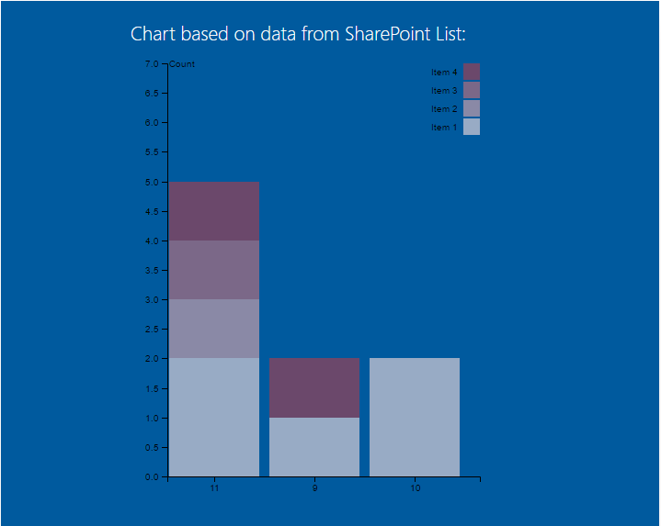

Slide 17
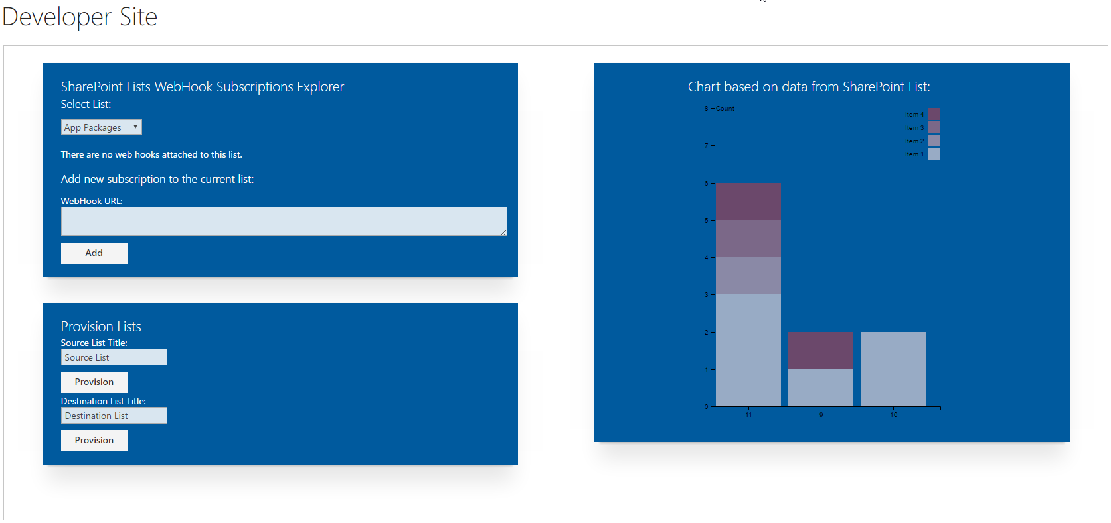

Slide 18
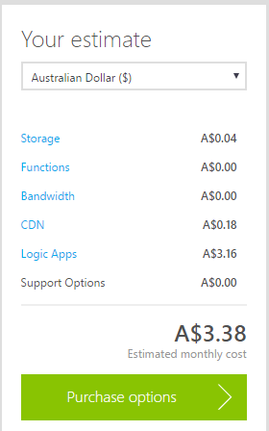
Costs?
1GB of Azure Blob Storage = $0.04 per month
500 Executions of Azure Functions = $0 per month
The first 400,000 GB/s of execution and 1,000,000 executions are free.
5GB of bandwidth = $0 per month
5GB of CDN Data = $0.18 per month
100 executions per day X 31 days = $3.16 per month

Slide 19
Questions?

